Slide 1
The Maximum density still life

Slide 2

Conway's Game of Life
The Game of Life (an example of a cellular automaton) is played on an infinite two-dimensional rectangular grid of cells. Each cell can be either alive or dead. The status of each cell changes each turn of the game (also called a generation) depending on the statuses of that cell's 8 neighbors. Neighbors of a cell are cells that touch that cell, either horizontal, vertical, or diagonal from that cell.

Slide 3

The configuration of live and dead cells at time t leads to a new configuration at time t+1 according to the rules of the game:
if a cell has exactly three living neighbours at time t, it is alive at time t+1
if a cell has exactly two living neighbours at time t it is in the same state at time t+1 as it was at time t
otherwise, the cell is dead at time t+1

Slide 4


Patterns
Many different types of patterns occur in the Game of Life, which are classified according to their behaviour. Common pattern types include:
still lifes, which do not change from one generation to the next;
oscillators, which return to their initial state after a finite number of generations;
spaceships, which translate themselves across the grid.

Slide 5
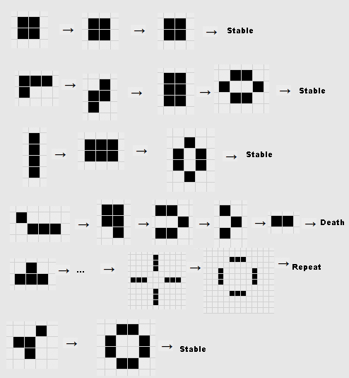

Slide 8
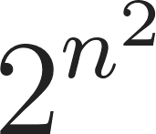
The Maximum Density Still Life Problem
The Maximum Density Still Life Problem is to find the maximum number
of live cells that can fit in an n × n region of an infinite board, so that the board is stable
under the rules of Conway’s Game of Life. It is considered a very difficult problem and
has a raw search space of O( ) . Previous state of the art methods could only solve
up to n = 20. We give a powerful reformulation of the problem into one of minimizing
“wastage” instead of maximizing the number of live cells. This reformulation allows us
to compute very strong upper bounds on the number of live cells, which dramatically
reduces the search space. It also gives us significant insights into the nature of the problem.
By combining these insights with several powerful techniques: remodeling, lazy clause
generation, bounded dynamic programming, relaxations, and custom search, we are able
to solve the Maximum Density Still Life Problem for all n. This is possible because the
Maximum Density Still Life Problem is in fact well behaved mathematically for sufficiently
large n (around n > 200) and if such very large instances can be solved, then there exist
ways to construct provably optimal solutions for all n from a finite set of base solutions.
Thus we show that the Maximum Density Still Life Problem has a closed form solution and
does not require exponential time to solve
▢ ▢ ▢ ▢ ▢ ▢ ▢
▢ ▢ ▢ ▢ ▢ ▢ ▢
▢ ▢ ▩ ▩ ▢ ▢ ▢
▢ ▢ ▩ ▢ ▩ ▢ ▢
▢ ▢ ▢ ▩ ▩ ▢ ▢
▢ ▢ ▢ ▢ ▢ ▢ ▢
▢ ▢ ▢ ▢ ▢ ▢ ▢

Slide 9
▢ ▢ ▢ ▢ ▢ ▢ ▢ ▢ ▢ ▢ ▢ ▢ ▢ ▢
▢ ▢ ▢ ▢ ▢ ▢ ▢ ▢ ▢ ▢ ▢ ▢ ▢ ▢
▢ ▢ ▩ ▩ ▢ ▩ ▩ ▢ ▩ ▩ ▢ ▩ ▢ ▢
▢ ▢ ▩ ▩ ▢ ▩ ▩ ▢ ▩ ▢ ▩ ▩ ▢ ▢
▢ ▢ ▢ ▢ ▢ ▢ ▢ ▢ ▩ ▢ ▢ ▢ ▢ ▢
▢ ▢ ▩ ▩ ▩ ▩ ▩ ▩ ▢ ▩ ▩ ▩ ▢ ▢
▢ ▢ ▩ ▢ ▢ ▢ ▢ ▢ ▩ ▢ ▢ ▩ ▢ ▢
▢ ▢ ▢ ▩ ▢ ▩ ▩ ▢ ▩ ▢ ▩ ▢ ▢ ▢
▢ ▢ ▩ ▩ ▢ ▩ ▩ ▢ ▩ ▢ ▩ ▩ ▢ ▢
▢ ▢ ▩ ▢ ▢ ▢ ▢ ▢ ▩ ▢ ▩ ▢ ▢ ▢
▢ ▢ ▢ ▩ ▢ ▩ ▩ ▢ ▩ ▢ ▩ ▢ ▢ ▢
▢ ▢ ▩ ▩ ▢ ▩ ▢ ▩ ▩ ▢ ▩ ▩ ▢ ▢
▢ ▢ ▢ ▢ ▢ ▢ ▢ ▢ ▢ ▢ ▢ ▢ ▢ ▢
▢ ▢ ▢ ▢ ▢ ▢ ▢ ▢ ▢ ▢ ▢ ▢ ▢ ▢
Optimal solution for n = 10

Slide 10
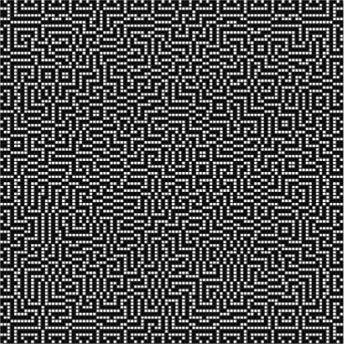
Optimal solution for n = 100

Slide 11
References
CHU, G. AND STUCKEY, P. J.
A complete solution to the Maximum Density Still Life Problem
In-text: (Chu & Stuckey, 2012)
Your Bibliography: Chu, G., & Stuckey, P. (2012). A complete solution to the Maximum Density Still Life Problem. Artificial Intelligence, 184-185, 1-16. https://doi.org/10.1016/j.artint.2012.02.001

